Slide 1





Maternal and Paternal Resources Across Childhood and Adolescence Predict Young Adult Achievement
Parental and Family Influence on Young Adult Wellbeing
Xiaoran Sun¹, Susan M. McHale¹, and Kimberly A. Updegraff²
¹The Pennsylvania State University
²Arizona State University

Slide 2


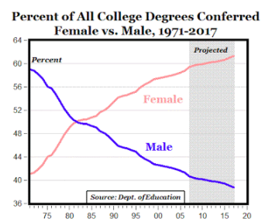
Background
Parental and Family Influence on Young Adult Wellbeing
Young adults’ educational and occupational achievements
Critical for well-being throughout adult life (IOM & NRC, 2015)
Can be traced to early experiences with mothers and fathers
Gender differences
In 1982, women began to outperform men in attainment of Bachelor’s degrees (Buchmann et al., 2008)
From 1972 to 2009, occupational gender segregation for young adults declined substantially (Hegewisch et al., 2010)

Slide 3
Background
Parental and Family Influence on Young Adult Wellbeing
Parents provide important resources for academic achievement and career development across childhood and adolescence. (Bryant, Zvonkovic, & Reynolds, 2006; Sirin, 2005; Steinberg, Lamborn, Dornbusch, & Darling, 1992)
However, much less is known about the longitudinal implications of parental resources for achievements in young adulthood.
Therefore, this study focuses on:
Parental resources
(parent attainment & parental warmth)
Educational and Occupational Achievement
Across middle childhood and adolescence
Young adulthood

Slide 4
Theoretical Base
Parental and Family Influence on Young Adult Wellbeing
Capital theory (Coleman, 1988)
Family capital generates youth achievement
Human capital (e.g., parent education & occupation)
Social capital (e.g., parent-youth relationships)

Slide 5
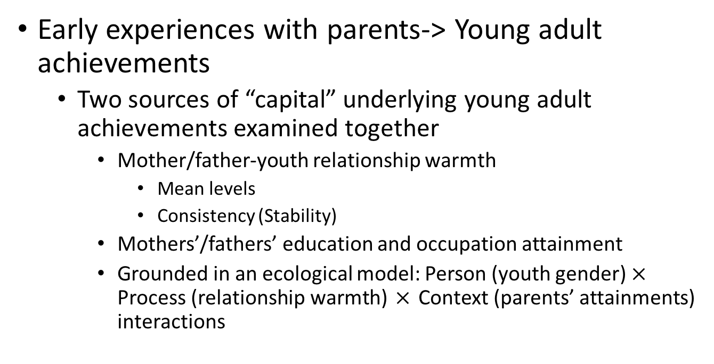
This Study
Parental and Family Influence on Young Adult Wellbeing
Early experiences with parents-> Young adult achievements
Two sources of “capital” underlying young adult achievements examined together
Mother/father-youth relationship warmth
Mean levels
Consistency (Stability)
Mothers’/fathers’ education and occupation attainment
Grounded in an ecological model: Person (youth gender) $×$ Process (relationship warmth) $×$ Context (parents’ attainments) interactions
Notes:
Adolescence is often described as a period of dramatic change, marked by perturbations in par- ent-youth warmth and conflict as parents and youth adjust, for example, to youth's increasing autonomy (Collins & Laursen, 2004; Steinberg & Silk, 2002). Although longitudinal studies indicate that relationship difficulties tend to stabilize or decline as youth approach adulthood (Loeber et al., 2000; Shanahan, McHale, Crouter, & Osgood, 2007; Steinberg & Silk, 2002), we could find no studies that examined whether ups and downs in parent-youth relationships across adolescence have long-term implica- tions for outcomes in young adulthood. Extant literature, however, has targeted parental consistency within more proximal time scales as a component of an authoritative parenting style, and shown that consistency in domains such as parental control, disci- pline, and expectations, as well as consistent family routines, is linked to adolescent adjustment and achievement (Roche & Ghazarian, 2011; Steinberg, 2001): Predictable parental behavior can promote a sense of control, providing youth with an arena of comfort (Roche & Ghazarian, 2011)that benefits their achievement.
Feeling of security

Slide 6
Participants
Parental and Family Influence on Young Adult Wellbeing
Penn State Family Relationships Project
(co-PIs: Susan M. McHale & Ann C. Crouter; NICHD R01-HD32336)
N = 164 families; 317 youth (52% female)
Mothers, fathers, first- & secondborns
11 time points
Time 1 to 9: annual home interviews
Firstborns: M = 11.80 years old at Time 1
Secondborns: M = 9.22 years old at Time 1
Time 10 & 11: young adult follow-ups; phone interviews
Firstborns: M = 26.26 at Time 10
Secondborns: M = 26.07 at Time 11

Slide 7
Measures
Parental and Family Influence on Young Adult Wellbeing
Parent-youth warmth (Times 1 to 9; Blyth & Foster-Clark, 1987)
Cross-time mean levels
Cross-time consistency
reverse-coded iSDs (Ram & Gerstorf, 2009): standard deviations across time
Educational attainment
Parents: Times 1 to 9
Young adults: Time 10 for firstborns, Time 11 for secondborns
Occupational prestige (ICPSR 9593; Davis, Smith, Hodge, Nakao, & Treas, 1991)
Covariates
Parent age
Young adult age

Slide 8

Analysis
Parental and Family Influence on Young Adult Wellbeing
Multilevel models
Two levels
Level 1: within-family
Relationship warmth indices, youth gender & age
Level 2: between-family
Parents’ attainments & age
Separate models for
mothers v. fathers
educational v. occupational achievements

Slide 9
Analysis
Parental and Family Influence on Young Adult Wellbeing
Effects examined:
Main effects:
Warmth cross-time mean
Warmth cross-time consistency
Parents’ attainment
Interactions:
Warmth mean X Parents’ attainment
Warmth mean X Parents’ attainment X gender
Warmth consistency X Parents’ attainment
Warmth consistency X Parents’ attainment X gender

Slide 10
Results
Parental and Family Influence on Young Adult Wellbeing
Parental resources from middle childhood through adolescence predicted young adults’ educational achievement
Parental warmth cross-time mean γ = .34, SE = .21, N.S.
Parental warmth cross-time consistency γ = 1.55, SE = .55, p <.01
Parent education γ = .22, SE = .06, p <.001
Interactions all N.S.

Slide 11
Results
Parental and Family Influence on Young Adult Wellbeing
Maternal resources from middle childhood through adolescence predicted young adults’ occupational prestige
Mother warmth cross-time mean γ = 2.84, SE = 1.90, N.S.
Mother warmth cross-time consistency γ = 14.82, SE = 5.22, p <.01
Mother prestige γ = .10, SE = .07, N.S.
Mother warmth consistency X Mother prestige X Youth gender γ = -1.57, SE = 0.75, p <.05

Slide 12
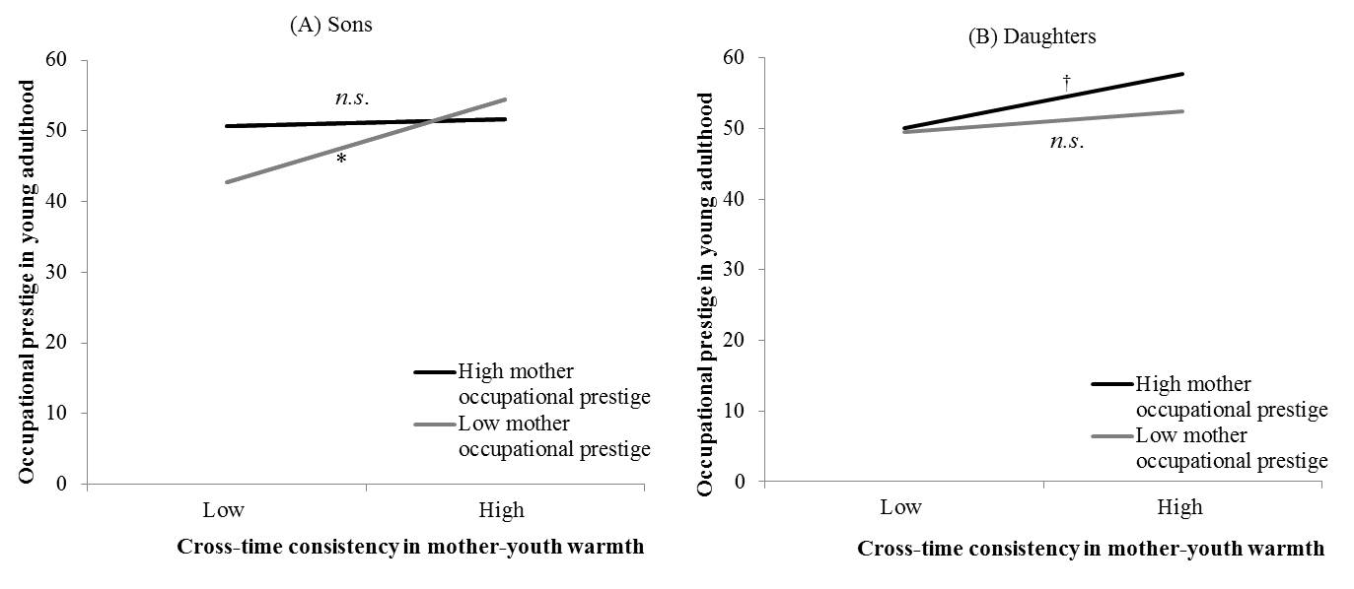
Mother warmth consistency X Mother prestige X Youth gender
Parental and Family Influence on Young Adult Wellbeing
(compensating effect)
(boosting effect)

Slide 13
Results
Parental and Family Influence on Young Adult Wellbeing
Paternal resources from middle childhood through adolescence predicted young adults’ occupational prestige
Father warmth cross-time mean γ = 3.16, SE = 1.75, p =.06
Father warmth cross-time consistency γ = 2.68, SE = 4.77, N.S.
Father prestige γ = .10, SE = .08, N.S.
Father prestige X Youth gender γ = .33, SE = .15, p <.05
Sons: γ = 0.26, SE =0.11, p = 0.02
Daughters: γ = -0.08, SE =0.11, N.S.

Slide 14
Take-home points
Parental and Family Influence on Young Adult Wellbeing
Longitudinal implications:
Experiences with mothers & fathers from middle childhood through adolescence predicted young adult achievements at age 26
Controlling for mean level, cross-time consistency in relationship warmth is important to achievement
For occupational achievement
mothers’ and fathers’ resources are differently linked to their sons’ versus daughters’ achievements
The effects of maternal warmth differ as a function of mothers’ occupation attainment

Slide 15

Limitations & Future directions
Parental and Family Influence on Young Adult Wellbeing
Links: correlational design does not allow for causal inferences; intervention studies needed
Sample: limits generalizability
Young adults were only around 26 years old; late bloomers may show different patterns

Slide 16
Contributions
Parental and Family Influence on Young Adult Wellbeing
Cross-time consistency in relationship warmth: an extension of prior research
Two sources of influence tested together: main effects & interactions
Both mothers and fathers
Moderating role of gender: implications for gender differences

Slide 17
Parental and Family Influence on Young Adult Wellbeing
Thanks!
Questions & Suggestions
xbs5014@psu.edu
Acknowledgement to:
Eunice Kennedy Shriver National Institute of Child Health and Human Development (Grant R01-HD32336)
The National Science Foundation
(IGERT Grant DGE-1144860, Big Data Social Science)
Sun, X., McHale, S. M., & Updegraff, K. A. (2017). Maternal and paternal resources across childhood and adolescence as predictors of young adult achievement. Journal of Vocational Behavior, 100, 111-123.

Slide 18
Policy & Intervention implications
Parental and Family Influence on Young Adult Wellbeing
For parent education programs: consistency matters
Support long-term benefits of parent education programs
Both mothers and fathers
Targeted intervention for boys with low-achieving mothers

Slide 19
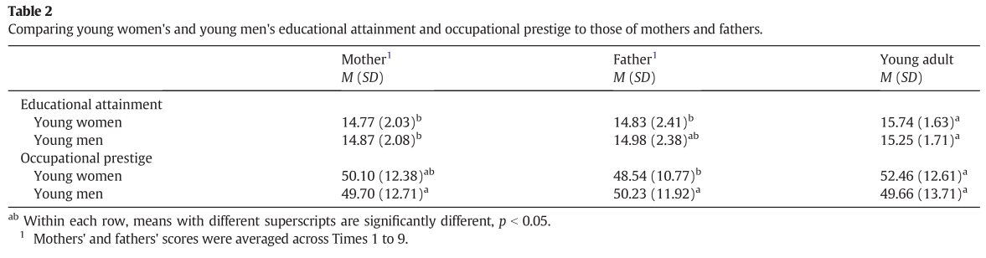
Results: Descriptives
Parental and Family Influence on Young Adult Wellbeing

Slide 20
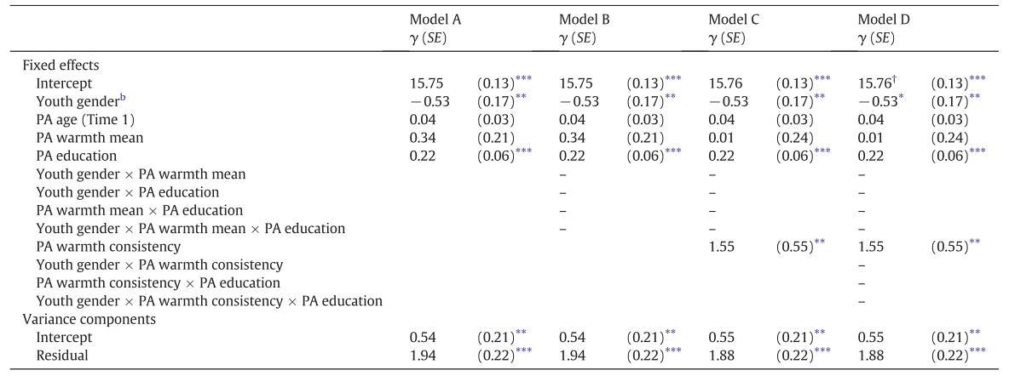
Results: Experiences with parents-> Educational attainment
Parental and Family Influence on Young Adult Wellbeing
Notes:
In preliminary tests, patterns of results were the same for models testing mothers' and fathers' predictors separately. For reasons of parsimony, therefore, we created mother-father average scores for each predictor and present results of the tests of the composite models

Slide 21
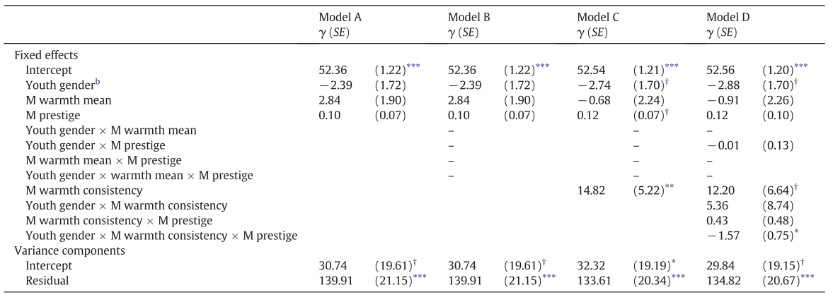
Results: Experiences with mothers-> Occupational prestige
Parental and Family Influence on Young Adult Wellbeing
Notes:
The results of the multilevel analyses predicting young adults' occupational achievement revealed distinct patterns for mother and father predictors.

Slide 22
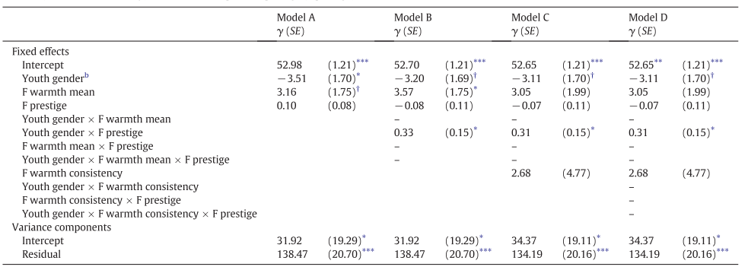
Results: Experiences with fathers-> Occupational prestige
Parental and Family Influence on Young Adult Wellbeing
Sons: γ = .26,*
Daughters: γ = -.08, N.S.
Notes:
The results of the multilevel analyses predicting young adults' occupational achievement revealed distinct patterns for mother and father predictors.

